Slide 1
Turn in your DBQ
Staple it to your plan sheet and research sheet. DBQ goes on top.
Or get out your planner for me to sign GRRRRRRRR.
Then sit and wait.

Slide 2
Transatlantic Slave Trade
“DEHUMANIZE”
….What might this mean in relation to slavery?

Slide 3
The demand for cheap labor to increase profits resulted in the brutality of the slave trade. *Dehumanize = to deprive a person of positive human qualities.

Slide 4
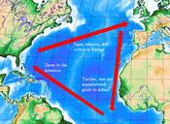
Triangular Trade across the Atlantic
What is Triangular Trade?
A three legged international trade network that links Europe, Africa, and the Americas.

Slide 5
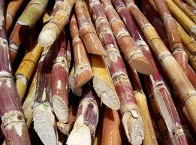
What did each Country have ?
Europe: guns, cloth, and cash
Africa: Slaves
The Americas: Sugar, molasses, cotton, furs, salt, and rum.

Slide 6
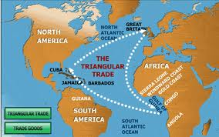
How did it work?
START: “first leg” Ships traveled from Europe with guns, cloth, and cash. They would give the resources to the leaders of African Tribes who would (in exchange) give them people.

Slide 7
Middle Passage
“Second leg” – Called the Middle Passage, The people would leave Africa on ships headed to the Americas in horrible conditions.

Slide 8
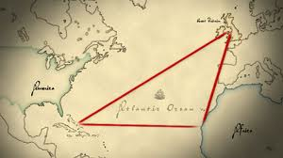
Final Leg
“Final leg” The slaves were traded in the Americas for sugar, molasses, cotton, furs and rum. These resources were returned to Europe for the whole process to start over again.

Slide 9
Effects of Triangular Trade
Merchants grew extremely wealthy.
Although there were risks in investing in Triangular trade, the profit outweighed the risks.
Port cities developed

Slide 10
The Middle Passage
For enslaved Africans, triangular trade was a horror.
African tribe leaders would capture them-
Men and women were bound with chains and forced to carry heavy loads.
Many captives died.
Some tried to escape, but would be captured and beaten.
They were held in warehouses until the Europeans arrived in boats to take them.

Slide 11
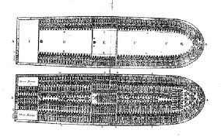
Dehumanizing Conditions
Once aboard the ships, they were packed in very tightly, many died on the journey.
Conditions were terrible and led to disease such as dysentery and smallpox .

Slide 12
Effects of Global Trade
The transfer of food and resources led to many people migrating or moving to a new area.
This lead to disease spreading all over the world, and some populations significantly decreased (such as native Americans).

Slide 13
Effects of Trade
In the 1500s, prices began to rise in Europe. However, there was much more money in circulation. A rise in the prices that is linked to a sharp increase in the amount of money available is called inflation.
This also led to European capitalism: a system where businesses are owned privately.
The idea of mercantilism: you must export more than you import to be wealthy

Slide 14
Trade Patterns

