Slide 1
Characteristics of Absolute Rulers in Europe
Objective: Identify the "10 Characteristics of an Absolute Ruler in Europe” and make a crown to prove your understanding ☺

Slide 2

Random King Louis XIV Fact
King Louis XIV of France, having never seen one, tried to eat an unpeeled pineapple and severely cut his lips.
He then had them banned from being imported into France for the duration of his reign.

Slide 3
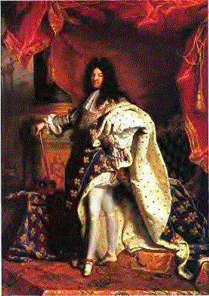
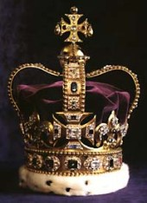
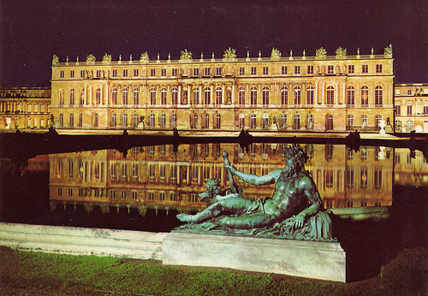
The Age of Absolutism

Slide 4
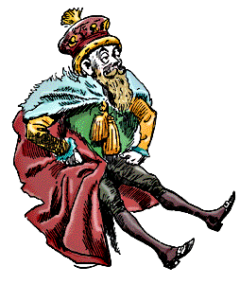
What is an Absolute Monarchy?
An Absolute Monarchy is a system of government in which the power of the government is held by one hereditary figure.
  In other words, a king or queen with unlimited power within their nation.

Slide 5
The Ten Characteristics of an Absolute Monarch
Protect and Expand the State
Maintain Public Order
Win the Support of the Nobility
Control the Nobility
Promote Economic Growth
Maintain an Independent Source of Revenue
Develop Nationalism
Inspire Loyalty
Use the Power of the Law
Establish a Sense of Purpose

Slide 6
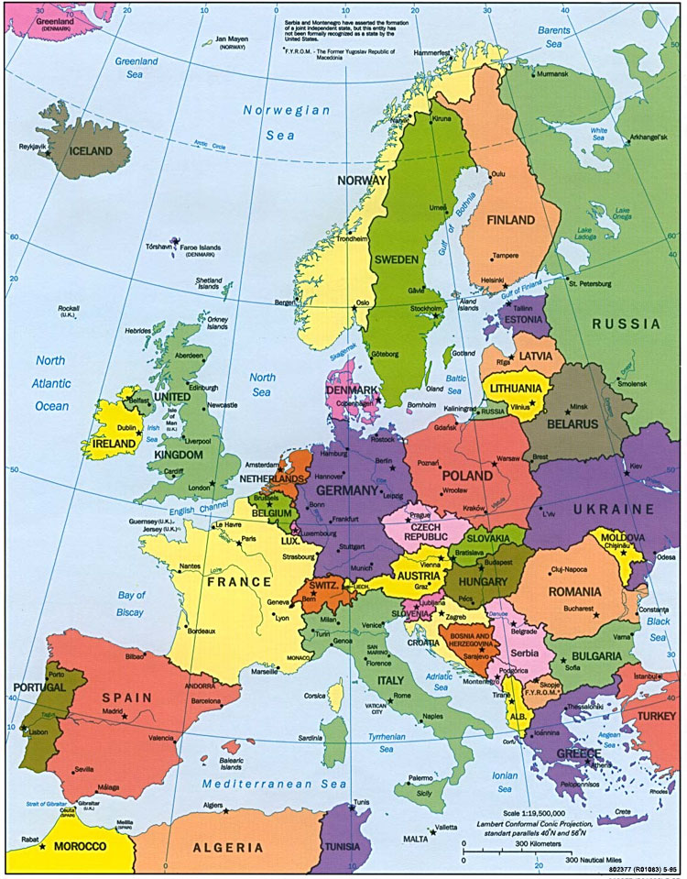
Protect and Expand the State
An absolute monarch takes steps to defend their kingdom by creating an army that answers to them.
They also seek to expand their kingdom through conquest, colonization, or by extending their influence.

Slide 7
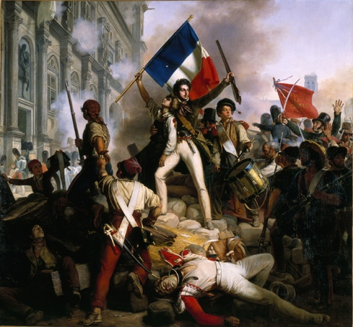
2. Maintain Public Order
An absolute monarch attempts to avoid uprisings and rebellions by force or by compromising with their citizens.

Slide 8
3. Win Support of the Nobility
An absolute monarch must find a way to gain the trust and support of the noble families.
  The monarch tries to limit the power of the nobles in order to increase their own power.

Slide 9
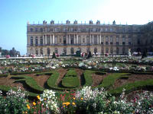
4. Control the Nobility
An absolute monarch uses multiple means to control the nobility.
  This may include bribing them or keeping them nearby to watch them.
    Many lived in the royal palace along with the royal family!

Slide 10
5. Promote Economic Growth
An absolute monarch uses economic principles to increase the nation’s wealth.
  This may include trade, colonial expansion, or investments in technology or education within their own country.

Slide 11

6. Maintain an Independent Source of Income
An absolute monarch maintains their own source of income that they can spend on their own projects.
  This may be through private ownership of land/investment, royal colonies, or royal taxation.

Slide 12


7. Develop Nationalism
An absolute monarch attempts to increase a strong emotional attachment to the nation through positive imagery, national anthems, or military successes.

Slide 13
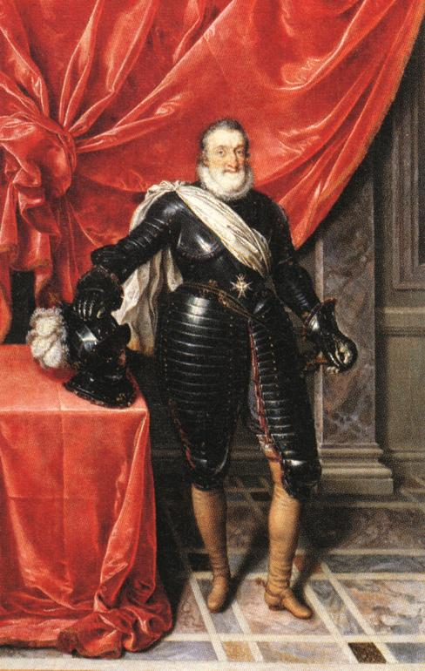
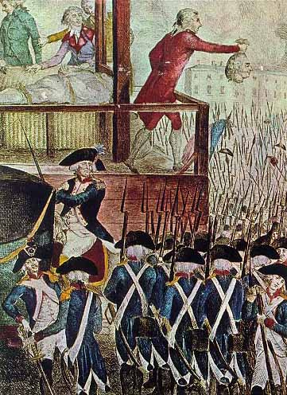
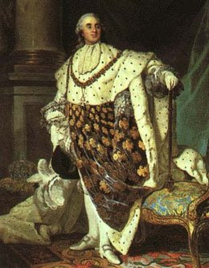
8. Inspire Loyalty
An absolute monarch is able to convince the citizens to have a sense of loyalty to them.

Slide 14
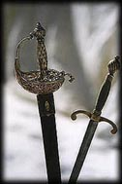
9. Use the Power of the Law
An absolute monarch uses police forces, military forces and the court systems to their advantage and to achieve their goals.

Slide 15
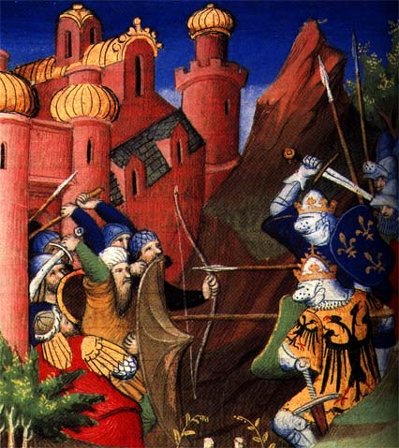
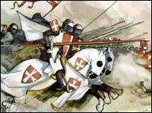
10. Establish a Sense of Purpose
An absolute monarch creates a sense of purpose within their nation.
  Examples might be religious defense, expansion, or creating a trade network.

Slide 16
10 Characteristics Crown Assignment
To demonstrate your understanding of the 10 characteristics of absolute monarchs, create a crown that includes:
  The word “absolute monarch” and definition somewhere on your crown
  Your name as “King ___” or “Queen ____”
  All TEN characteristics surrounding the definition
  Visual picture for each characteristic
  Add COLOR!
  Finish for homework if not completed in class!

Slide 17
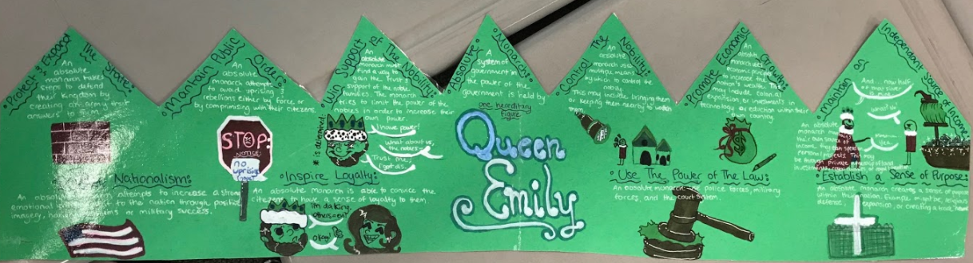
Example

