Slide 1
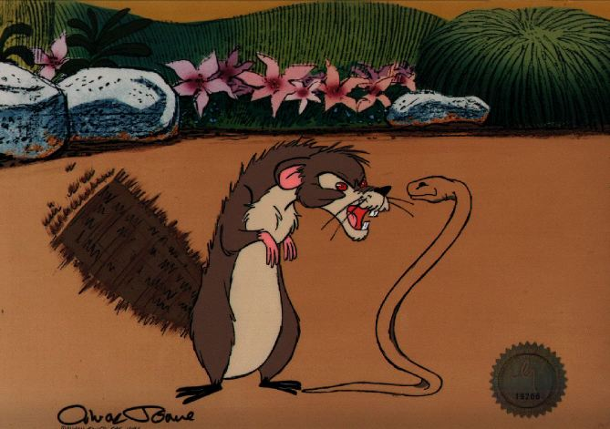
“Rikki-tikki-tavi” By: Rudyard Kipling

Slide 2
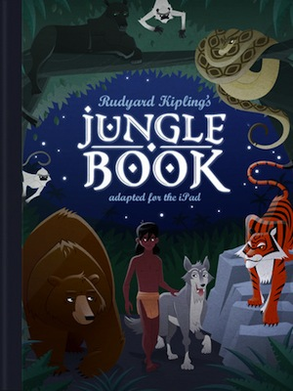
Author: Rudyard Kipling
Grew up in India
Inspired by the people, animals, landscapes
His other works include
The Jungle Book (1894)
The Second Jungle Book (1895)
Kim (1901)
Just So Stories (1902)

Slide 3
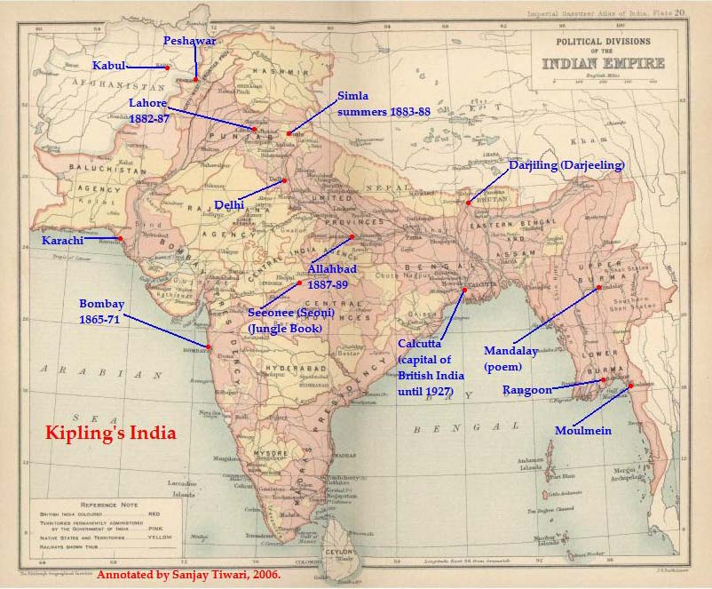
“Mother of Cities to me, For I was born in her gate, Between the palms and the sea, Where the world-end steamers wait.” -R. Kipling
Setting: India

Slide 4
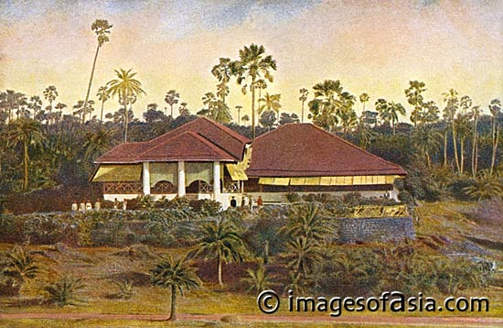
Rudyard Kipling’s “Back Yard”

Slide 5
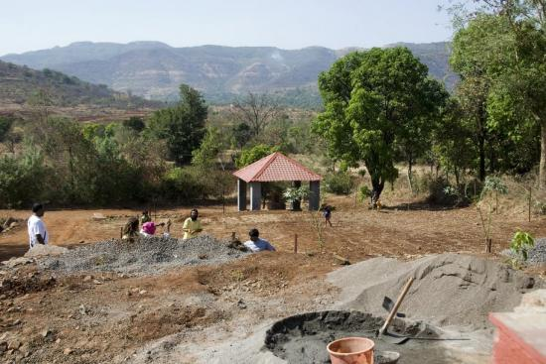
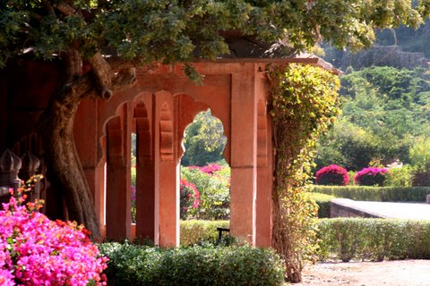

Slide 6
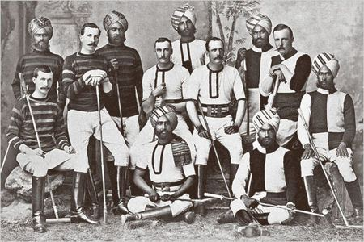
India was colonized by England

Slide 7
British East India Company
Traded goods for England’s profits, using Indians as near-slaves to do all the dirty work for them

Slide 8
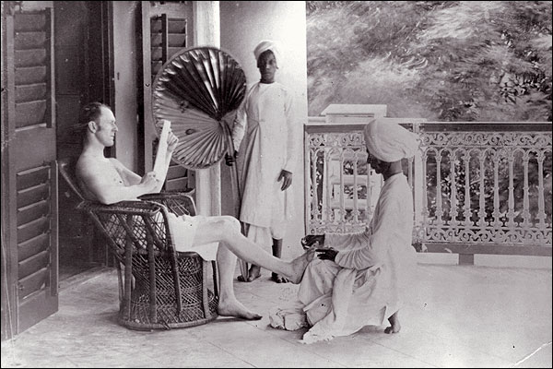

Slide 9
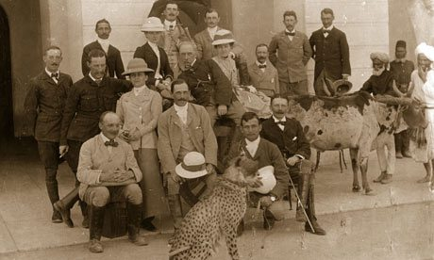
Many English colonists lived in India with their families during the colonization period.

Slide 10
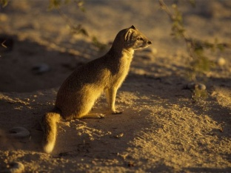
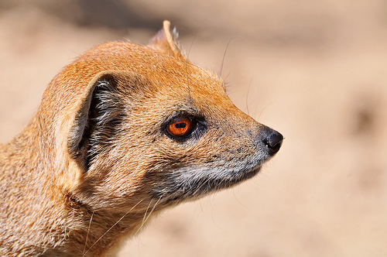
The MONGOOSE
The Mongoose is from a family of 33 species of small carnivores from southern Europe, Asia and Africa known as a predator of poisonous snakes.
The mongoose has a similar appearance to the weasel or a meerkat. Mongooses tend to stand on their hind legs to survey their surroundings.
The mongoose’s eyes can appear to flash red when they are angry or startled.

Slide 11
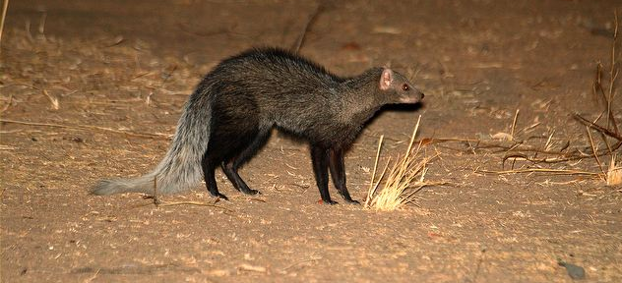
Mongoose Habits
Some types of mongoose are nocturnal, while others emerge during daylight hours.
The mongoose is very fast enabling them to move so quickly that they can avoid strikes from a snake. They often live in burrows.

Slide 12
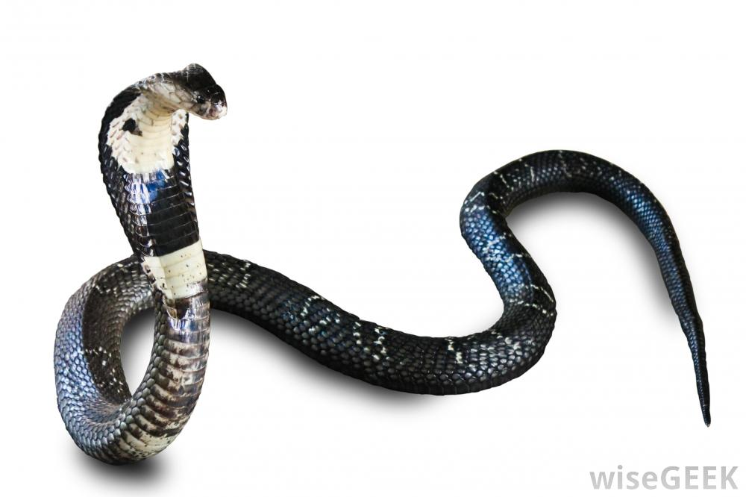
The Cobra
The Indian cobra not only bites to transmit venom, but it spits it too. It can force the venom through its fangs using its muscles. The poison is very harmful to the eyes.
The mongoose was so prized for its ability to kill not only snakes, but rats as well, that travelers to the Caribbean, Hawaii, and Fiji brought mongooses with them for protection.

Slide 13
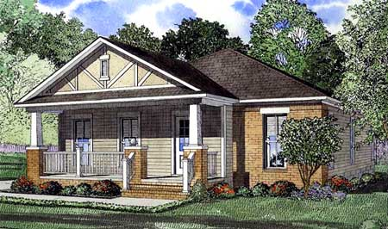
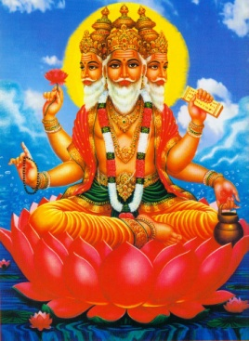
Vocabulary
bungalow-noun- a one-story house with low, sweeping lines.
revive- verb- come back to life or consciousness
cultivate- adjective- tamed; developed
cower- verb- to crouch or draw back in fear
The great God Brahm- the Hindu god of creation
Notes:
THERE ARE 2 SLIDES FOR VOCABULARY

Slide 14
Vocabulary
providence- noun- God’s care and help, a godsend
purchase-noun- a firm hold
singe- verb- burn a little
fancy-verb- to picture oneself; imagine
valiant-adjective- showing courage, brav

Slide 15
pg. 199

