Slide 1
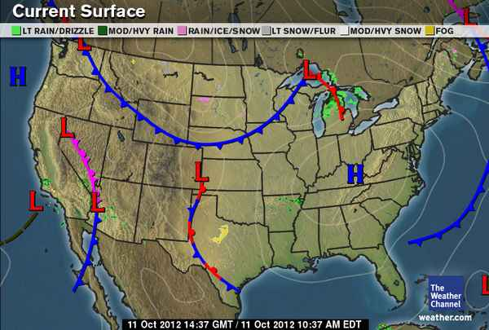
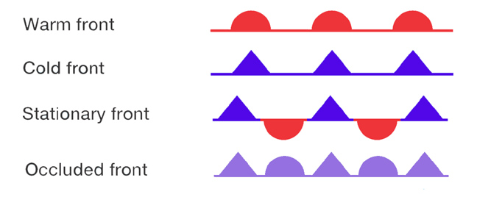
Surface Maps - also show fronts

Slide 2
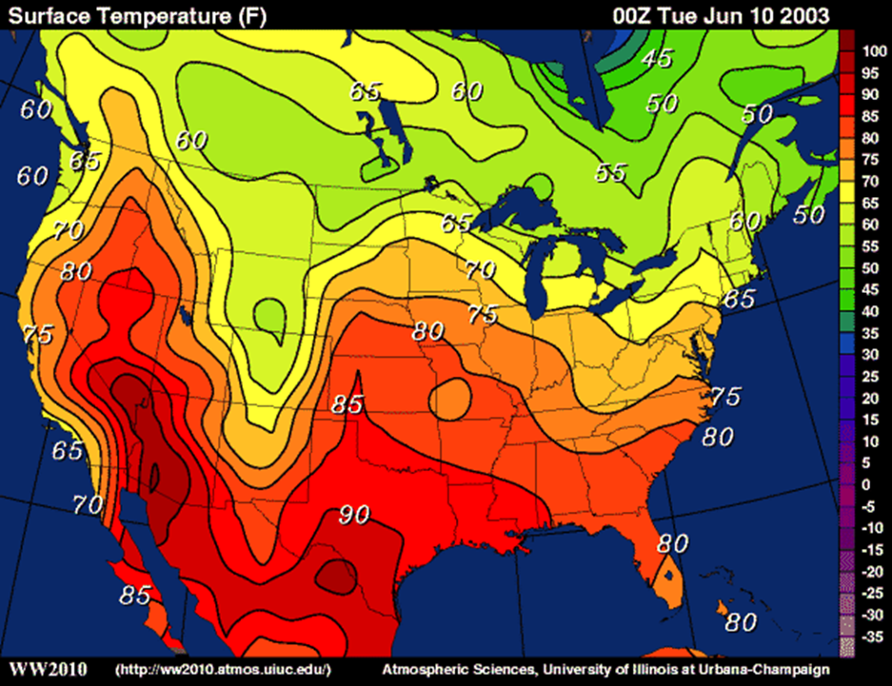
  Isotherms – contour lines on a map that connect areas of equal temperature.

Slide 3
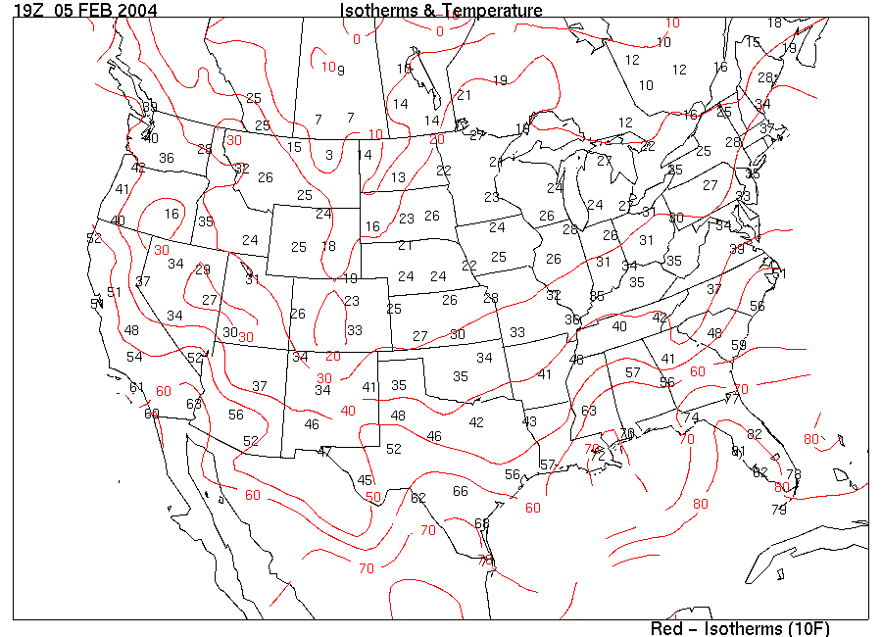
Isotherms

Slide 4
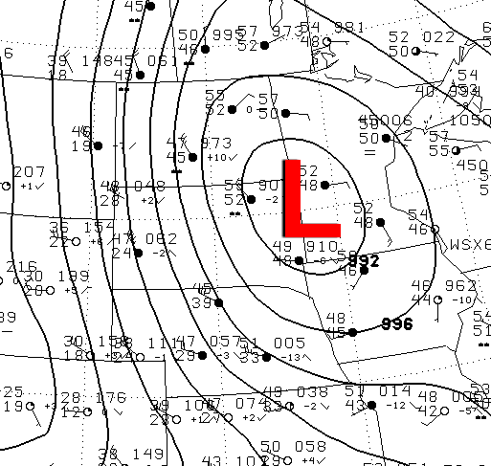
Isobars – contour lines on a map that connect areas of equal atmospheric pressure.
Isobars and isotherms are somewhat “fluid” measures, so their lines on a map tend to be curved and irregular.

Slide 5
Weather Map Practice

Slide 6
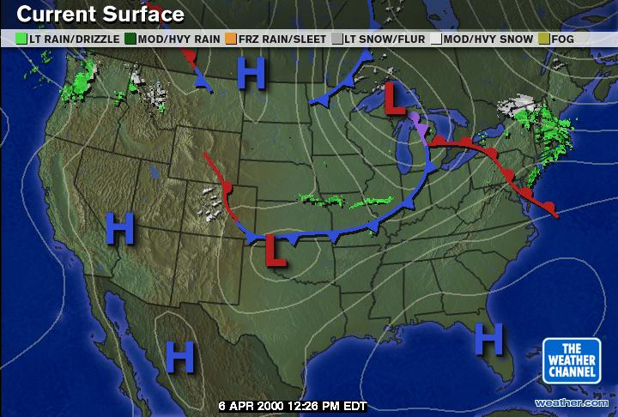
Where are high pressure and low pressure systems on this map?
Low Pressure
High Pressure

Slide 7
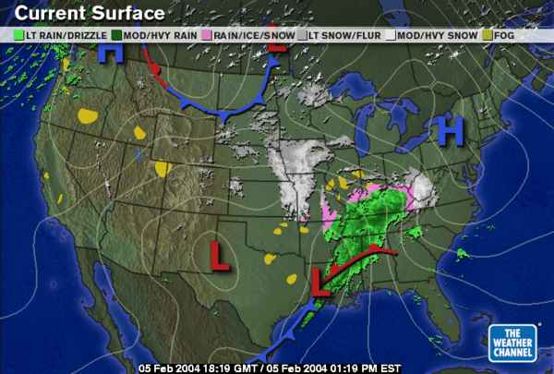
Where are the fronts?
What types of precipitation are on this surface map?

Slide 8
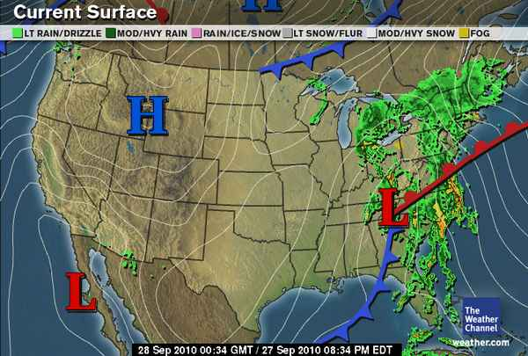
Where are the fronts?
What types of precipitation are on this surface map?

Slide 9
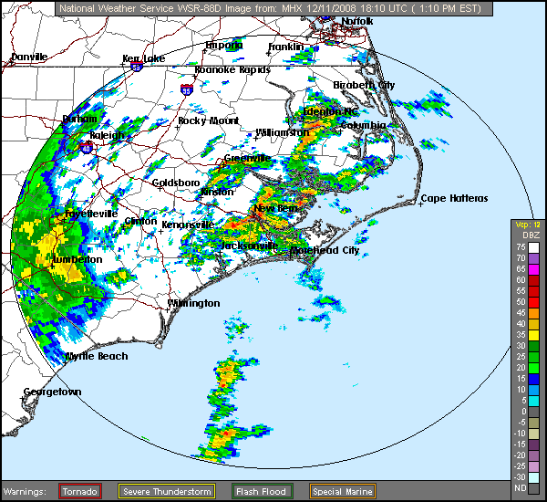
What do the different colors represent?

Slide 10
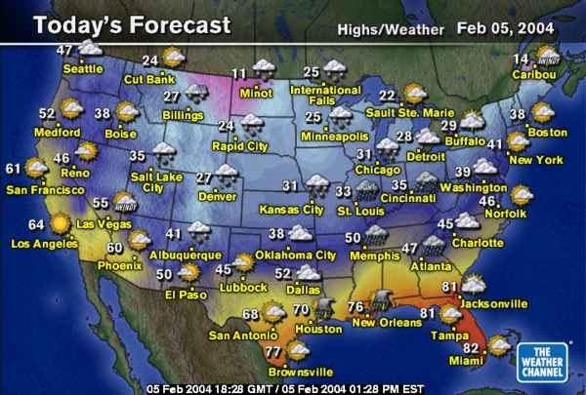
What does this map tell us?

Slide 11
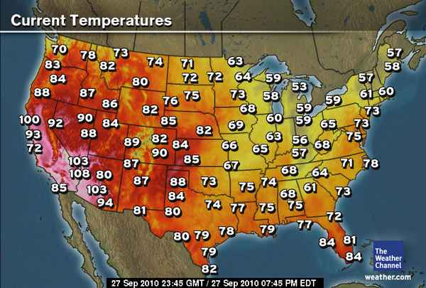
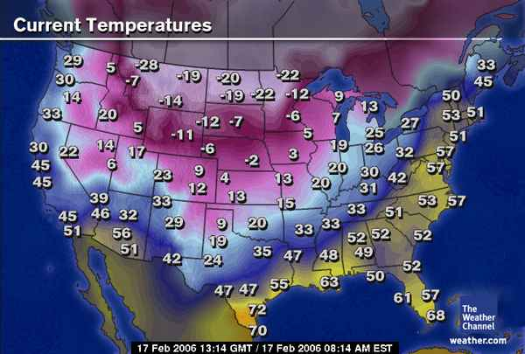
What is different with these maps?

Slide 12
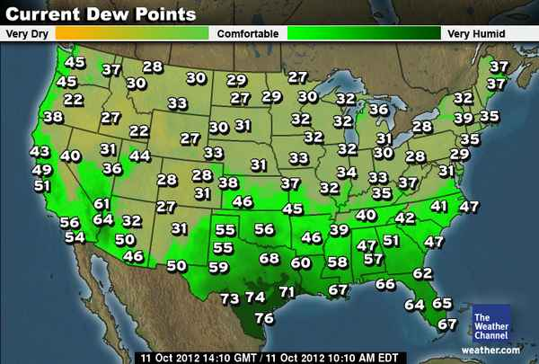
Where would it be uncomfortable to visit? Why?

Slide 13
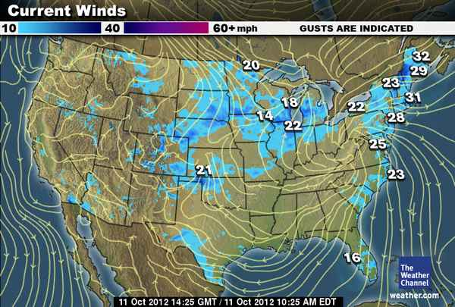
Explain what we can learn from this map.

Slide 14
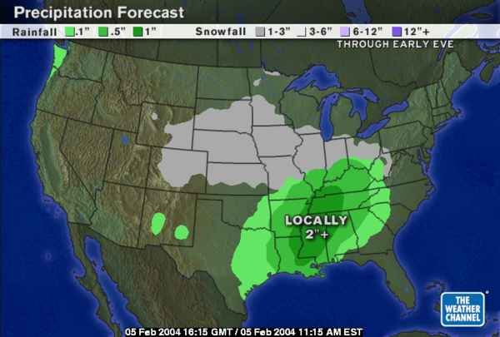
What does this map tell us about the forecast?

Slide 15
Reflection Questions
Why does the Earth have weather?
How do weather maps show how global patterns of atmospheric movement influence local weather?

