Slide 1
Reading Weather Maps and Forecasting Weather

Slide 2
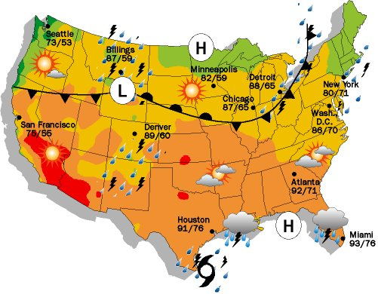
Weather Maps
Are used to show a variety of weather conditions in a particular area.
They show current weather conditions.
They are also used to predict future weather conditions.

Slide 3
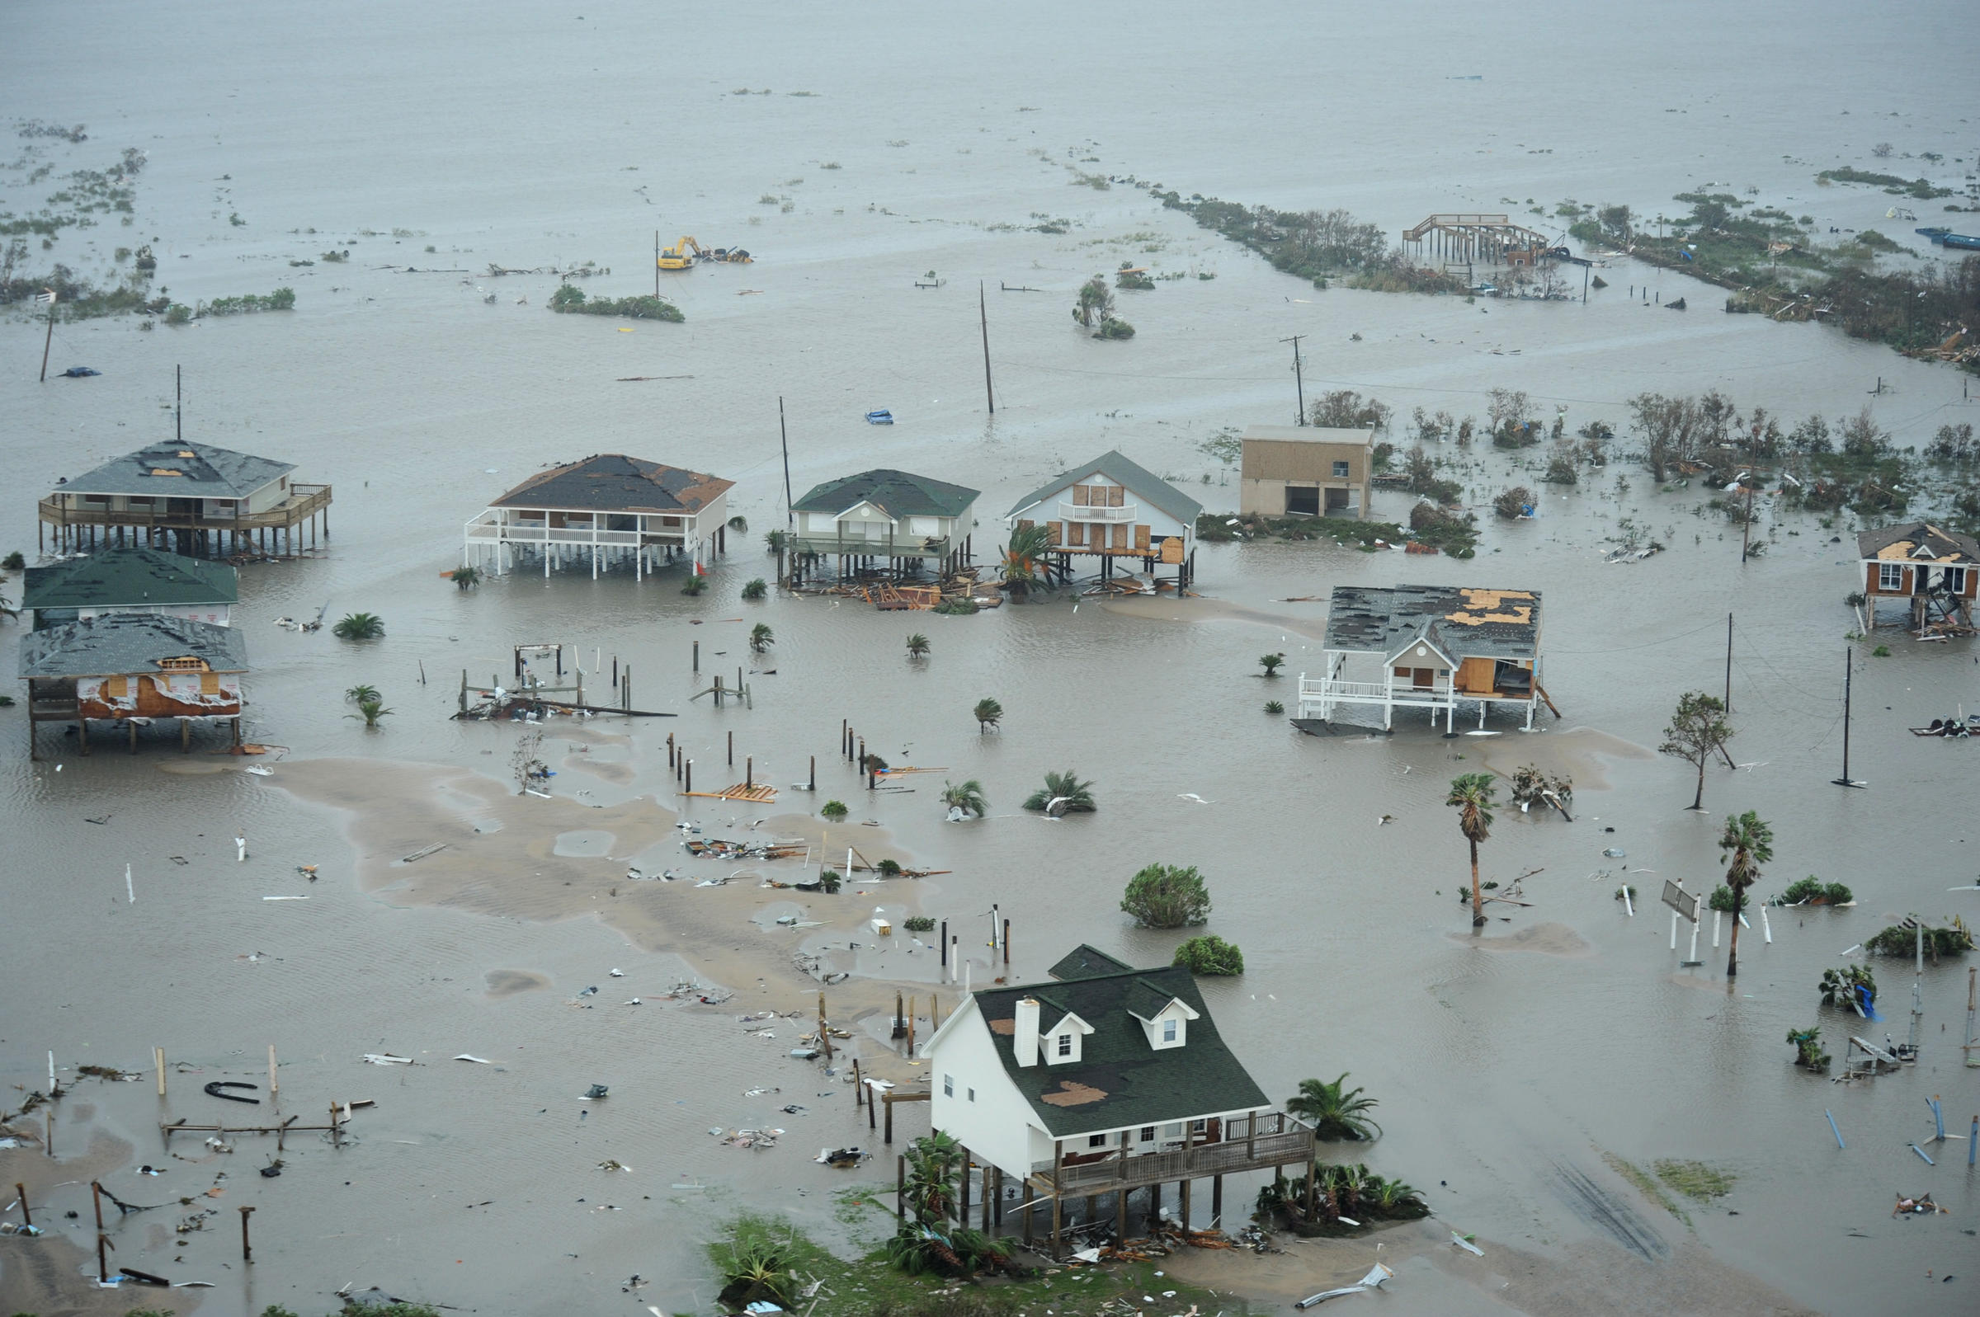
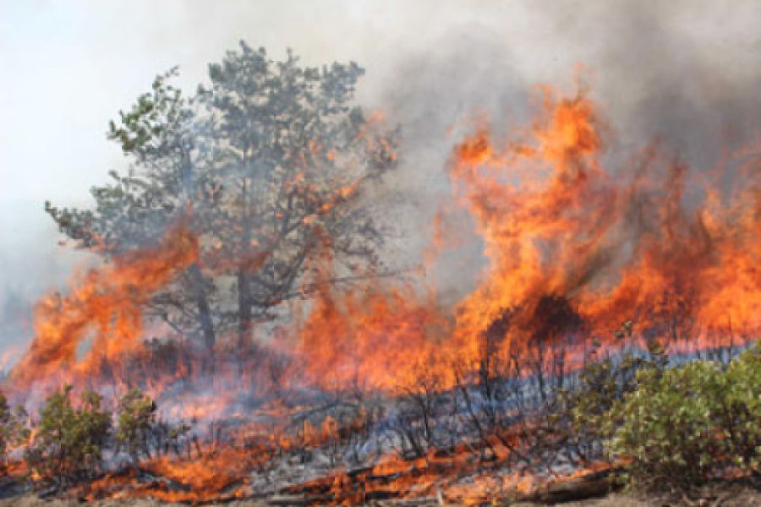
Weather is….
The condition of the atmosphere outside at any given time.
We need to understand weather because it impacts our daily activities, agriculture, transportation and commerce.

Slide 4
Meteorologists…
Scientists who study and predict the weather.
Their predictions are called forecasts.

Slide 5
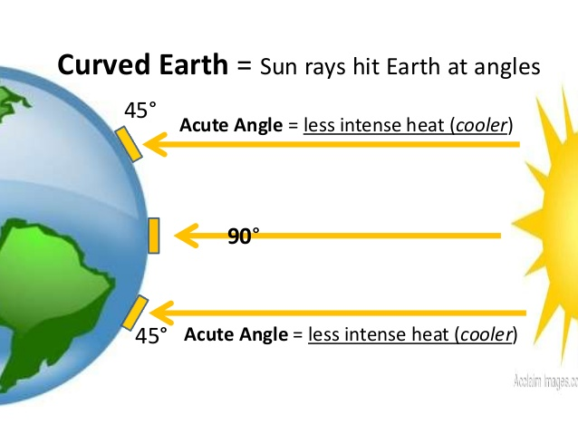
What causes weather?
Weather happens because the sun warms the Earth more near the equator than it does at the poles.
This uneven heating causes large masses of air with different temperatures to form.
As these air masses move, they cause changes in the weather.

Slide 6
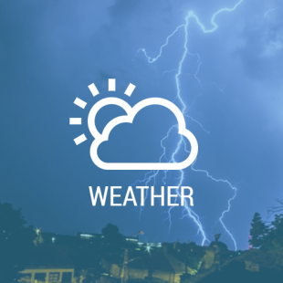
Weather Forecasting
Forecasting the weather include six main elements:
Temperature
Air Pressure
Wind Speed and Direction
Humidity
Precipitation
Cloud Coverage

Slide 7
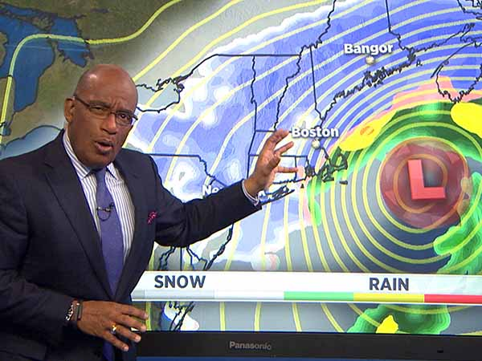
Weather Forecasting
The more data meteorologists can gather, the better they can forecast the weather.
Meteorologists use a variety of tools to collect data in forecasting the weather.

Slide 8
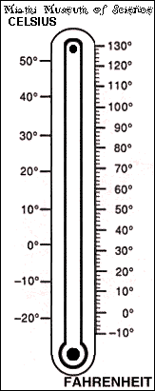
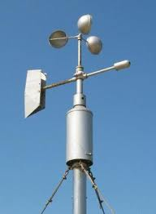
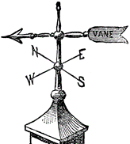
Weather Forecasting
The most common weather instruments are:
A thermometer is a weather tool used to measure the temperature.
An anemometer is a weather tool that measures wind speed.
By observing wind vanes, we can know the direction of the wind.

Slide 9
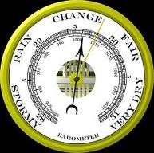
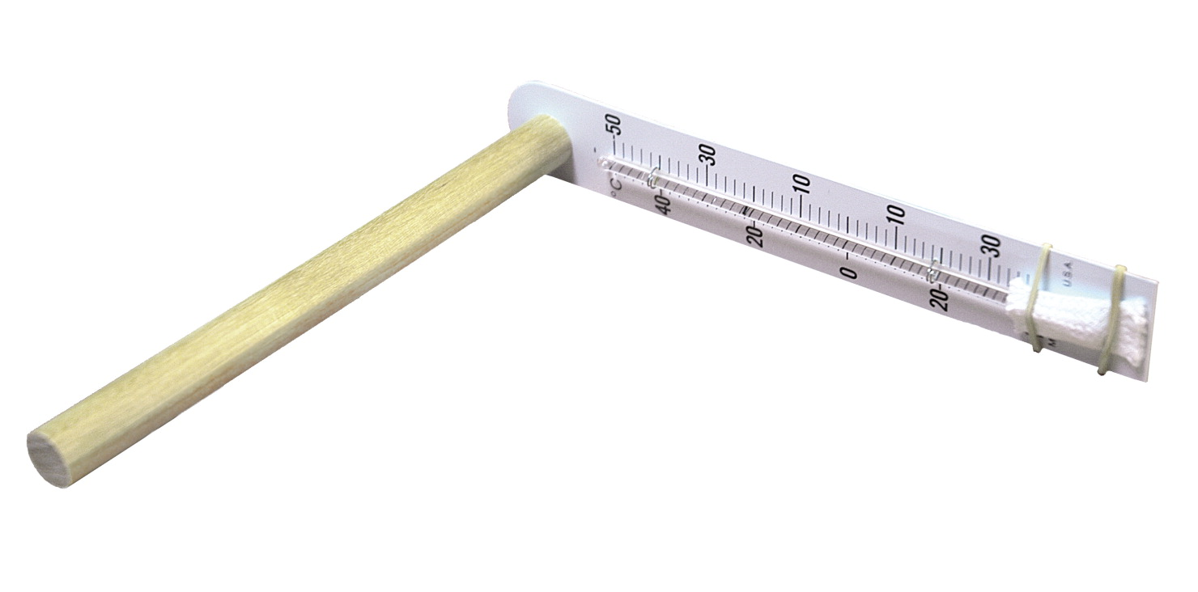
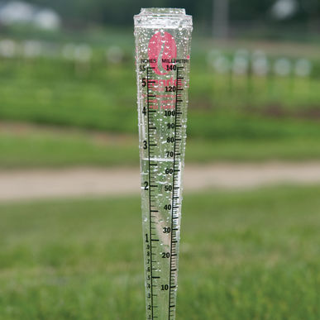
Barometers measure air pressure. Knowing the air pressure can help predict fair or rainy weather.
Psychrometers measure the wet bulb and dry bulb temperatures. The difference is used to determine humidity in the atmosphere.
A rain gauge is used to collect precipitation.

