Slide 1
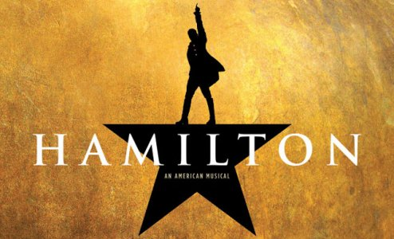
The American Revolution
The Declaration of Independence was a formal demand for separation, but the Revolutionary War had already begun in 1775:
  Lexington & Concord
  Formation of a Continental Army under George Washington
  Americans were divided among Patriots, Loyalists, & Neutrals

Slide 2
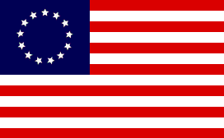

Loyalists vs. Patriots
Loyalists (Tories)
  American Colonists who remained loyal to the British during the war.
  OK for Britain to tax the colonies due to the protection they received during the French and Indian War.
  Felt strong social and economic ties to Britain and believed the British would win the war.
  About a third of the colonists remained loyalists throughout the war.
  Were happy to remain British subjects forever
Patriots
  Desired complete and total independence from Britain
  Motto based from the quote of Patrick Henry “Give Me Liberty or Give Me Death”
  Inspired by Common Sense by Thomas Paine
  Made up the troops in Washington’s Continental Army and third of the colonial population.
  Nicknamed “rabble-rousers” which means disorderly mob

Slide 3
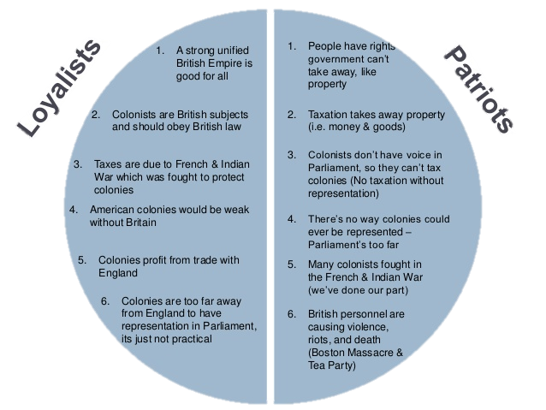

Slide 4
Neutrals
Neutrals
  Were undecided on the war.
  Many disagreed with British policies but did not want to declare independence
  Made up a third of the population.

Slide 5

PATRIOT: Alexander Hamilton
Founding Father of America
Joined forces with the Patriots in their protest of British-imposed taxes
Defended the actions of the First Continental Congress with essays A Full Vindication of the Measures of Congress (1774) and The Farmer Refuted (1775)
LOYALIST: Samuel Seabury
Against all unlawful congresses and committees (like the Continental Congress)
Wrote "Free Thoughts on the Proceedings of the Continental Congress" bashing their work
  “If I must be enslaved, let it be by a KING at least, and not by a parcel of upstart, lawless Committeemen.”

Slide 6
https://www.youtube.com/watch?v=sDJ-ixhFGJE Farmer Refuted
https://www.youtube.com/watch?v=Rgiyq7rqWhg You’ll Be Back
https://www.youtube.com/watch?v=NBkI_9cr1Ws Trailer

