Slide 1
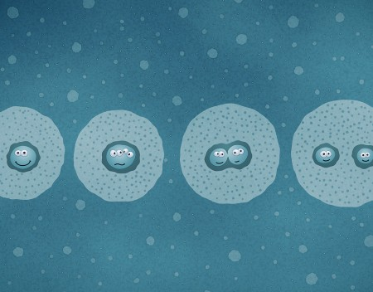
Cell Division
& Mitosis

Slide 2
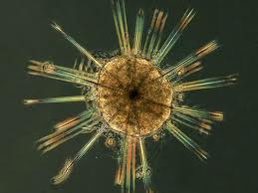
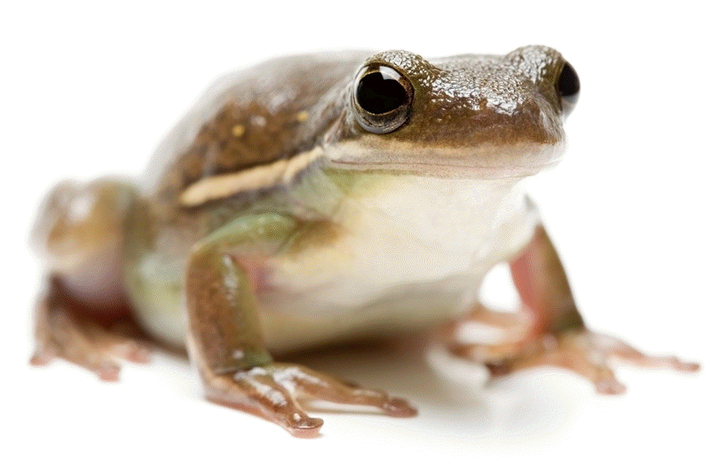
Why do Cells Divide?
Reminder…
Organisms that have only one cell are called…
unicellular
Organisms made of more than one cell are called…
multicellular
Unicellular organisms - cell division is ONLY for the purpose of reproduction
Multicellular organisms – use cell division for growth, development, repair and reproduction.

Slide 3
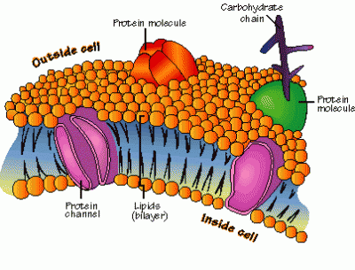
Growth
Cells can grow in size, but there is a limit to how large a cell can get.
Cells need a lot of surface area because the materials that it needs to function travel across its cell membrane.
As a cell gets bigger, its needs increase to a larger degree than its surface area, so it will divide instead of growing bigger and bigger.

Slide 4
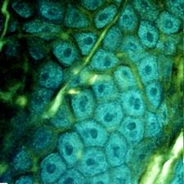
Development
Multicellular organisms all start as one cell and grow larger through cell division.
But, cell division is not the only thing that leads to the development of an organism.
During development, cells become specialized to perform specific functions like; skin cells, liver cells, brain cells, etc.
Skin Cells
Smooth muscle cells

Slide 5
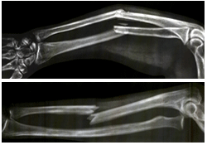
Repair
The body repairs injuries, like cuts and broken bones, through cell division.
Cells also get old and die and need to be replaced.

Slide 6
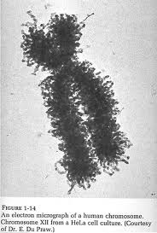
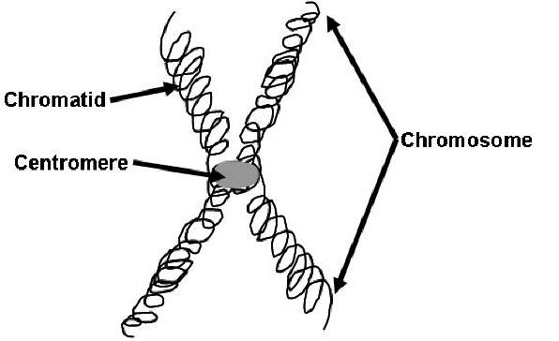
What part of the cell is involved in cell division?
DNA (Deoxyribonucleic Acid) - the chemical that contains information for an organism’s growth and function
Chromosomes- DNA wrapped around proteins and compacted into two chromatids held together by a centromere.

Slide 7
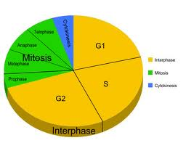
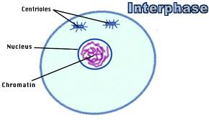
The Cell Cycle
Cell cycle - the normal sequence
of development and division of a
cell
Interphase- normal cell function, part of cell cycle before division occurs. DNA duplicates exactly.

Slide 8
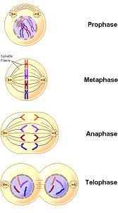
Cell Cycle Continued
2. Mitosis- nucleus divides (eukaryotes only- cells with a nucleus)
Four steps
Prophase- chromosomes form and the membrane around the nucleus disappears
Metaphase- chromosome line up in the middle of the cell
Anaphase- chromatids split and are pulled to opposite sides of the cell
Telophase- nuclei form, new nuclear membranes develop

Slide 9
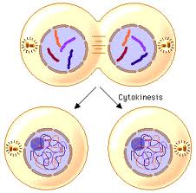
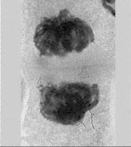
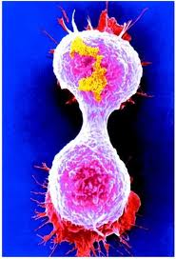
Cell Cycle continued
3. Cytokinesis- cytoplasm divides. Two new, identical daughter cells form.

Slide 10
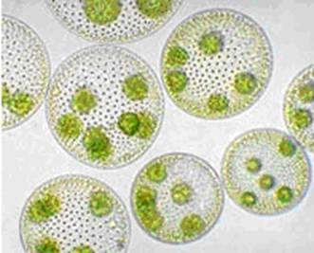
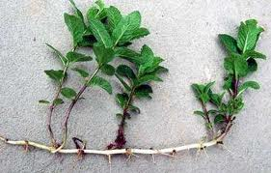
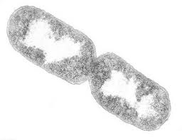
Cell Division in Reproduction
Asexual reproduction- one organism produces one or more new, identical organisms that can live independently (most unicellular organisms and a few multi-cellular organisms reproduce this way)

Slide 11
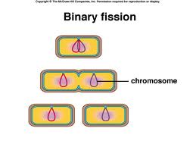
Asexual Reproduction
Binary fission- prokaryotic (cells with NO nucleus), unicellular organisms. Cell division is reproduction. Cytokinesis only.
Bacteria reproduce this way.
Eukaryotic, unicellular organisms
undergo mitosis and
Cytokinesis. (algae, yeast,
protozoan)

Slide 12
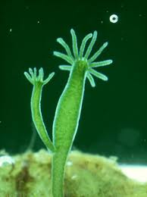
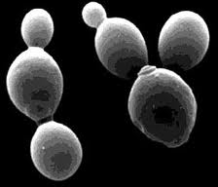
Asexual Reproduction continued
2. Budding- organisms develop tiny buds on their bodies which grow into new, complete organisms and then break free. (Hydra, some types of plants)

Slide 13
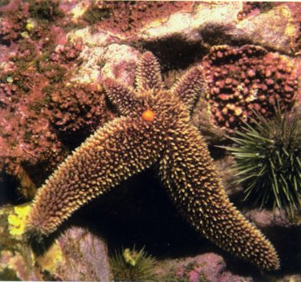
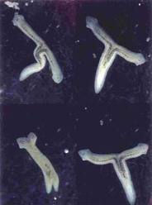
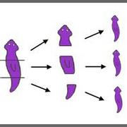
Asexual Reproduction continued
Regeneration- new tissue growth at the site of a lost limb (starfish, Planaria)

Slide 14
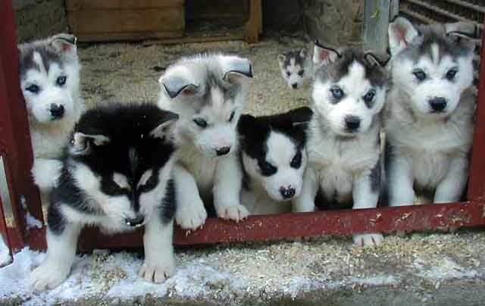
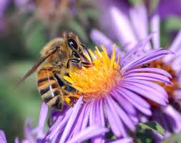
Sexual Reproduction
Sexual reproduction - genetic material from two parents. Allows for great diversity.

